Slide 1

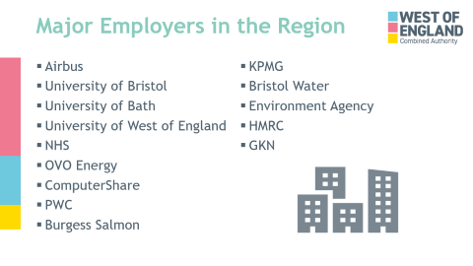
Major Employers in the Region
Airbus
University of Bristol
University of Bath
University of West of England
NHS
OVO Energy
ComputerShare
PWC
Burgess Salmon
KPMG
Bristol Water
Environment Agency
HMRC
GKN

Slide 2
Labour Market Intelligence
Charlotte Hopley,
Senior Economic Officer

Slide 3
West of England
The West of England covers the four authority areas of:
Bristol City Council
Bath and North East Somerset
North Somerset
South Gloucestershire
90% of the people who live in the West of England also work here.

Slide 4
What is Labour Market Intelligence?
Information into the structure of employment and the jobs available in a given area
Looks at what employers there are, and what sectors they are in.
What type of jobs people are doing
What skills are required
How employment in an area may change

Slide 5
How can this information be used?
Identify jobs & employers of interest
Increased Employability
Inform training and course decisions
What skills and qualifications are needed

Slide 6

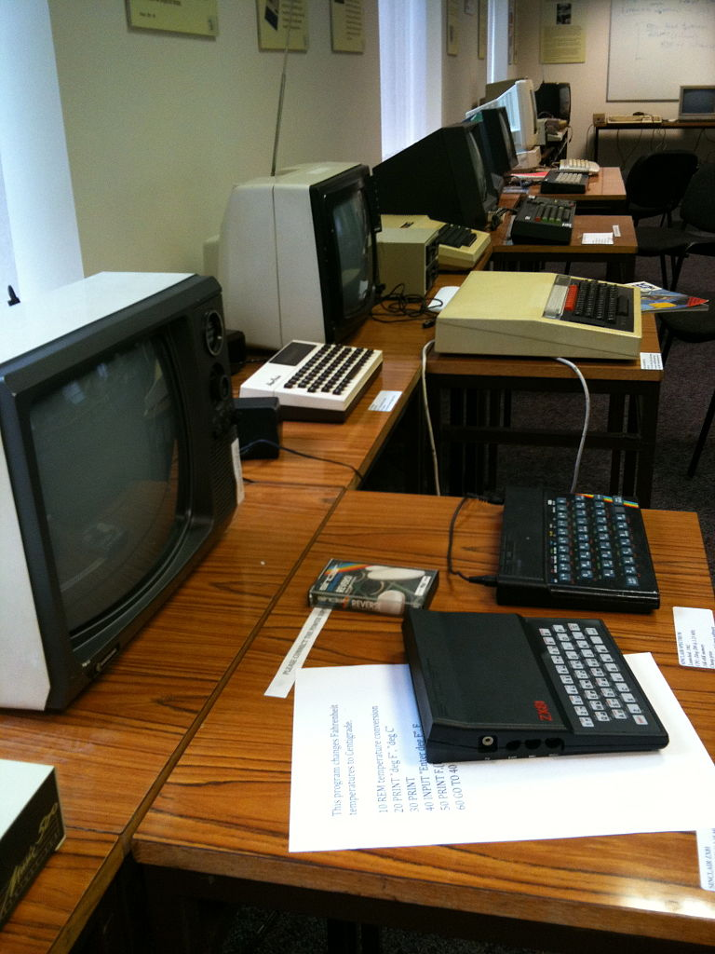
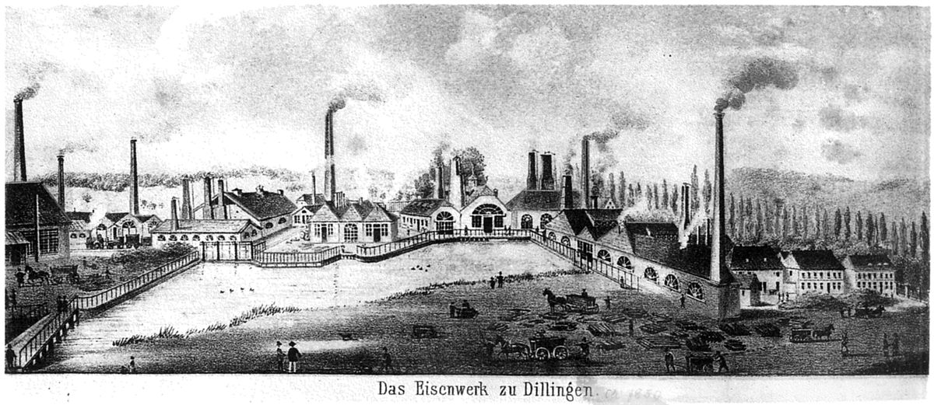



Employment is constantly changing

Slide 7
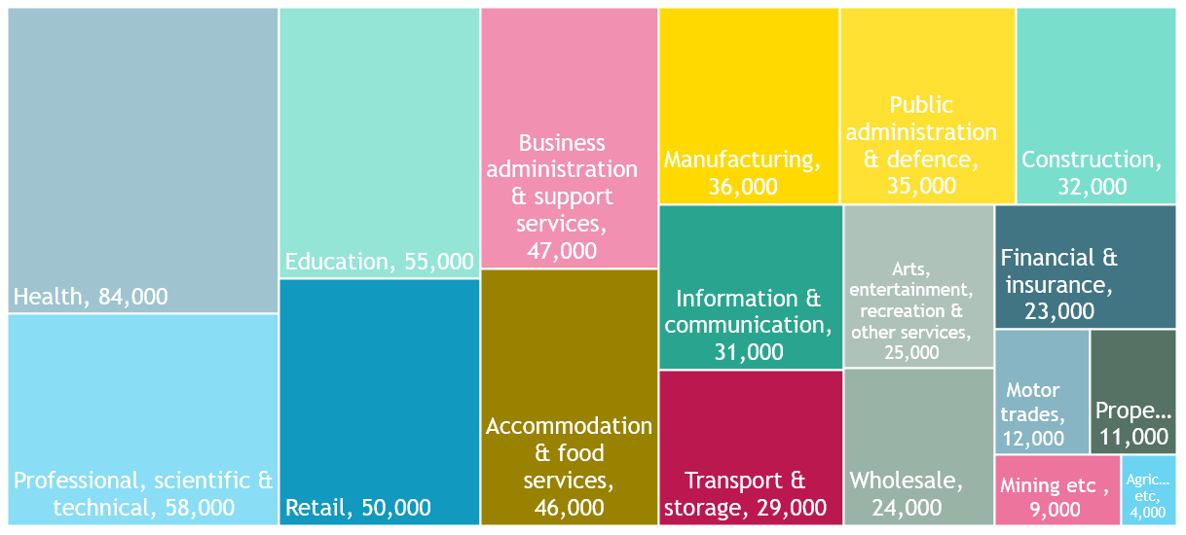
What industries are people currently employed in?
Source: BRES 2018, ONS
Notes:
There are currently about 612,000 people employed in the West of England across a wide range of sectors.

Slide 8
What occupations do they do?
Source: Jan – Dec 2018Annual Population Survey, ONS

Slide 9
The role of small businesses
Q: How many businesses in the West of England employ 1-4 people?
A: 34,935
Q: How many businesses in the West of England employ more than 250 people?
A: 200
There are around 44,800 SME businesses in the West of England employing from 1-249 people.
Source: UK Business Counts, ONS
Notes:
Question how many businesses do you think there are in the west of England that employ 1-4 people?

Slide 10
Top recruiting Businesses in 2019
Source: Jan- Dec, 2019 Labour Insight, Burning Glass

Slide 11
Sought after Occupations
Source: Jan- Dec, 2019 Labour Insight, Burning Glass

Slide 12
Professional Occupations in Demand
Source: Jan- Dec, 2019 Labour Insight, Burning Glass

Slide 13
Associate Professional & Technical Occupations in Demand
Source: Jan- Dec, 2019 Labour Insight, Burning Glass

Slide 14


Jobs in the NHS
Top 10 advertised jobs:
Registered General Nurse
Physician
Administrative Assistant
Healthcare Assistant
Nurse Practitioner
Healthcare Manager
Medical Secretary
Psychologist
Personal Care Aide
Physiotherapist
Source: Jan- Dec, 2019 Labour Insight, Burning Glass

Slide 15
Skills Sought by the NHS
Baseline Skills | Specialist Skills | Digital Skills
Communication Skills | Working With Patient: Mental Health | Microsoft Excel
Organisational Skills | Patient Care | Microsoft Office
Research | Surgery | Microsoft Word
English | Teamwork / Collaboration | LinkedIn
Leadership | Teaching | SQL
Planning | Administrative Support | Microsoft Outlook
Detail-Orientated | Rehabilitation | Microsoft Powerpoint
Typing | Working With Patient: Trauma | Word Processing
Microsoft Excel | Paediatrics | ICD-10
Problem Solving | Cancer knowledge | SAS
Transferable Skills
Source: Jan- Dec, 2019 Labour Insight, Burning Glass

Slide 16
Health Care Certifications
Registered General Nurse (RGN)
Nursing and Midwifery Council (NMC) Registration
Health and Care Professions Council (HCPC) Registration
General Medical Council (GMC) Registration
General Dental Council (GDC) Registration
Cavendish Care Certificate
British Association of Occupational Therapists (BAOT) Registration
Physiotherapist
Source: Jan- Dec, 2019 Labour Insight, Burning Glass

Slide 17
Average Earnings in Health
Source: Jan- Dec, 2019 Labour Insight, Burning Glass

Slide 18



Jobs in Legal and Finance
Top 10 advertised jobs:
Solicitor ((Property, Litigation, Corporate, Family, Employment, Construction)
Assistant Manager
Lawyer
Paralegal
Tax Manager
Legal Assistant
Audit Manager
Accountant
Conveyancer
Senior Auditor
Source: Jan- Dec, 2019 Labour Insight, Burning Glass

Slide 19
Skills Sought in Legal & Finance
Baseline Skills | Specialist Skills | Digital Skills
Communication Skills | Business Development | Microsoft Excel
Organisational Skills | Teamwork / Collaboration | Microsoft Office
Planning | Litigation | Microsoft Powerpoint
Detail-Orientated | Accounting | Microsoft Word
Microsoft Excel | Client Base Retention | SQL
Building Effective Relationships | Customer Service | Software Development
Problem Solving | Customer Contact | Visual Design
Research | Project Management | Java
Writing | Budgeting | Facebook
Meeting Deadlines | Professional Services Marketing | Microsoft C#
Transferable Skills
Source: Jan- Dec, 2019 Labour Insight, Burning Glass

Slide 20


Earnings & Certifications in Legal and Finance
Mean advertised salary £43,000 per annum
Common Certifications
Chartered Accountant (ICAS)
Legal Practice Course (LPC)
Chartered Certified Accountant (ACCA)
Association of Taxation Technicians (ATT) Qualification
APM Project Management (APMP)
City and Guilds Diploma in Accounting
Source: Jan- Dec, 2019 Labour Insight, Burning Glass

Slide 21



Top Jobs Requiring STEM Skills
Top 10 advertised jobs in STEM
Software Development Engineer
Front End Developer
Maintenance Engineer
Senior Systems Engineer
Electrical Engineer
Mechanical Engineer
.Net Developer
Java Software Developer
Computer Support Engineer
Civil Engineer
Source: Jan- Dec, 2019 Labour Insight, Burning Glass

Slide 22
Additional Skills in STEM jobs
Baseline Skills | Specialist Skills | Digital Skills
Communication Skills | Teamwork / Collaboration | Software Development
Planning | Project Management | JavaScript
Problem Solving | Software Development | SQL
Research | JavaScript | Software Engineering
Writing | SQL | Microsoft C#
Organisational Skills | Customer Service | Java
Creativity | Software Engineering | Python
Detail-Orientated | Budgeting | Microsoft Excel
Microsoft Excel | Microsoft C# | LINUX
Microsoft Office | Java | Microsoft Office
Transferable
Source: Jan- Dec, 2019 Labour Insight, Burning Glass

Slide 23
Average Earnings for STEM Jobs
Source: Jan- Dec, 2019 Labour Insight, Burning Glass

Slide 24
Skill Shortages
Source: Employer Skills Survey

Slide 25
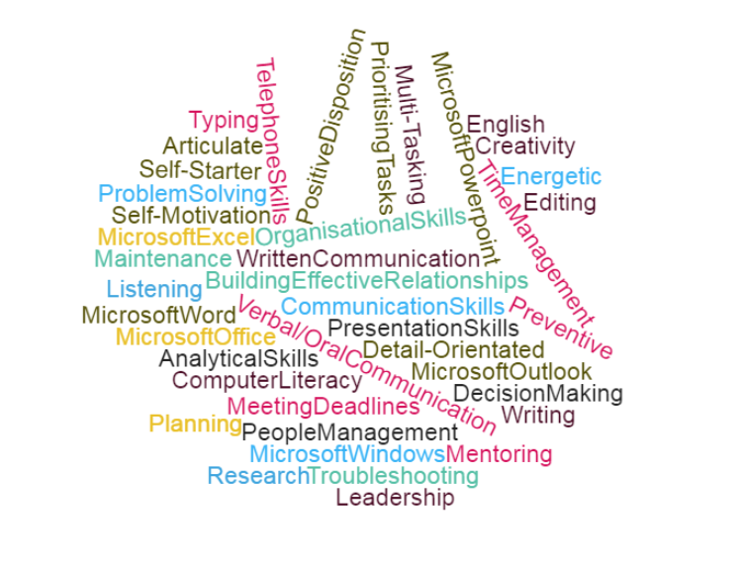
Baseline Employability Skills
Source: Jan- Dec, 2019 Labour Insight, Burning Glass

Slide 26


Future Skills
It is anticipated that nearly half of all existing jobs will be transformed by technology.
  whilst technological progress will make some occupations obsolete, it also creates new jobs
6 out of 10 adults lacking basic ICT skills or having no computer expertise.
Importance of retraining and upskilling!
This Photo by Unknown Author is licensed under CC BY-SA

Slide 27
Helpful Links
https://www.careerpilot.org.uk/
https://www.edge.co.uk/sites/default/files/documents/skills_shortage_bulletin_6_web-2.pdf
https://assets.publishing.service.gov.uk/government/uploads/system/uploads/attachment_data/file/483159/LMI_Summary_-_West_of_England__Final_.pdf
https://app.yondur.com/en/register/i

Slide 28

Contact us
westofengland-ca.gov.uk
xxxx@WestOfEngland-CA.gov.uk
0117 428 6210
WestofEnglandCA
West-of-England-Combined-Authority

